Slide 1
Chapter 15
Artificial Intelligence

Slide 2
Learning Objectives (1 of 2)
Describe the two types of artificial intelligence
Explain the pros and cons of various knowledge representation methods
Explain the parts of a simple neural network, how it works, and how it can incorporate machine learning
Describe how intelligent state–space search algorithms work
Give examples of possible usage for each of the following: swarm intelligence, intelligent agents, and expert systems

Slide 3
Learning Objectives (2 of 2)
Explain what a robot is, and list some tasks for which robots are currently suited
Explain what a drone is, and list some tasks drones can perform

Slide 4
Introduction (1 of 2)
Artificial Intelligence (AI): creating computer systems that exhibit aspects of intelligence
What is intelligence?
The Turing Test
Human judge questions two hidden entities
One entity is a person
One entity is a computer
If judge cannot distinguish computer from person, then computer is intelligent!

Slide 5
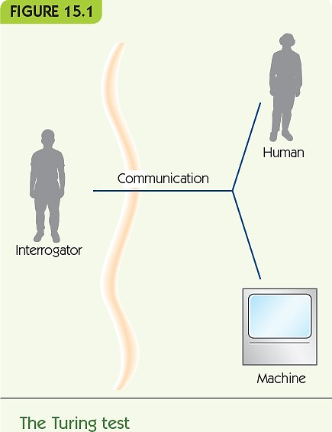
Introduction (2 of 2)

Slide 6
A Division of Labor (1 of 4)
Computational tasks
Example: managing a payroll
Recognition tasks
Example: recognizing an individual’s face
Reasoning tasks
Example: planning your major in college

Slide 7
A Division of Labor (2 of 4)
Computational tasks
Typically have algorithmic solutions
Computers perform faster than humans
Computers perform more accurately than humans
Recognition tasks
Process massive amounts of sensory information
Access massive amounts of past experience
Require approximation
Humans perform much better than computers

Slide 8
A Division of Labor (3 of 4)
Reasoning tasks
Formal reasoning can be automated to some extent
Problems become intractable quickly
Common-sense reasoning
Requires great experience and knowledge

Slide 9
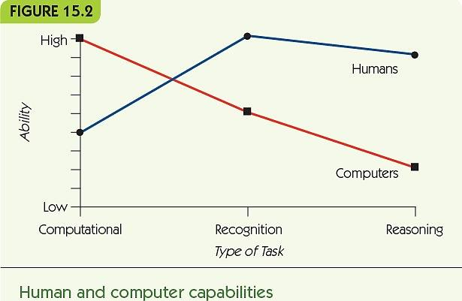
A Division of Labor (4 of 4)

Slide 10
Knowledge Representation (1 of 5)
How can we represent knowledge for the computer?
Natural language
Use requires understanding of the meanings of words and combinations of words
“Spot is a brown dog”
“Every dog has four legs”
Formal language
Language of formal logic
“Spot is a brown dog” becomes
dog(Spot) AND brown(Spot)

Slide 11
Knowledge Representation (2 of 5)
“Every dog has four legs” becomes
For every x, if x is a dog then x has four legs
(∀x) dog(x) -> four-legged(x)
Pictorial representation
Knowledge as a digital picture
Cannot represent categorical information
Example: every dog has four legs
Graphical representation
Knowledge as nodes connected by edges

Slide 12
Knowledge Representation (3 of 5)
Semantic net
Nodes for objects or categories of objects
Edges for relationships
Nodes inherit features through “isa” relationships

Slide 13
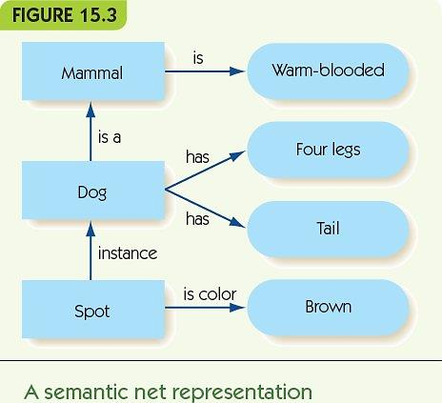
Knowledge Representation (4 of 5)

Slide 14
Knowledge Representation (5 of 5)
Requirements of a representation
Adequacy: must capture all relevant information
Efficiency: avoid redundant information
Extendability: easy to add new knowledge
Appropriate: easy to use for particular purpose

Slide 15
Recognition Tasks (1 of 12)
Some AI work attempts to mimic the brain
Humans have 86 billion (10¹²) neurons
A neuron receives electrical stimuli from other neurons through dendrites
A neuron sends electrical stimuli through its axon
Signals pass through gaps, synapses
Some synapses cause increased activation; others inhibit activation
Neurons are like very simple computational devices

Slide 16
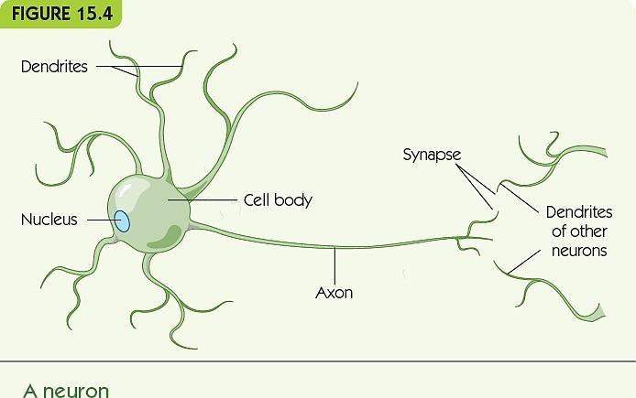
Recognition Tasks (2 of 12)

Slide 17
Recognition Tasks (3 of 12)
The nervous system is like a connectionist architecture
Processing arises from many simple processors with rich and complex connections
Processing in the brain occurs in a massively parallel way
Individual neurons are slow compared to computer computational speeds
Allows for redundancy and neuron failure (fault tolerant)

Slide 18
Recognition Tasks (4 of 12)
Artificial neural networks mimic the connectionist approach
Individual artificial “neurons” have:
A threshold for generating output
An activation level
Incoming weighted edges
Outgoing weighted edges

Slide 19
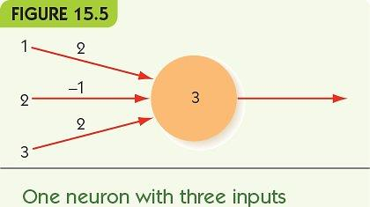
Recognition Tasks (5 of 12)

Slide 20
Recognition Tasks (6 of 12)
Neural networks are often organized into input and output layers
To provide an input to the network, fix the values of the input layer to 0 or 1
Output nodes compute weighted sum of all inputs
Activation from node i to node j is w_{ij} * x_{i}

Slide 21
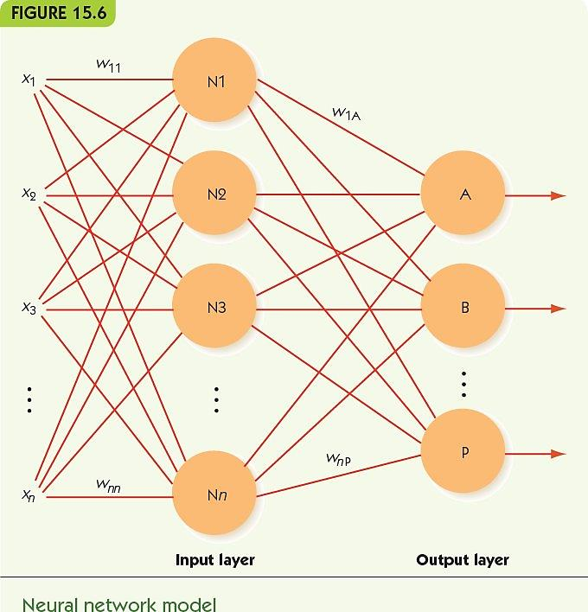
Recognition Tasks (7 of 12)

Slide 22
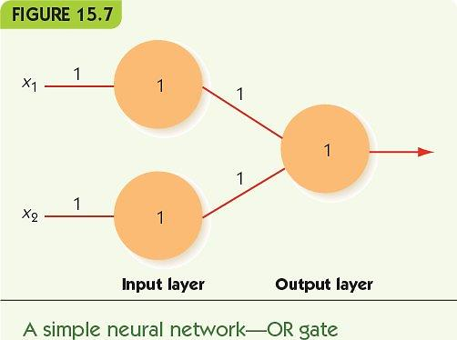
Recognition Tasks (8 of 12)

Slide 23
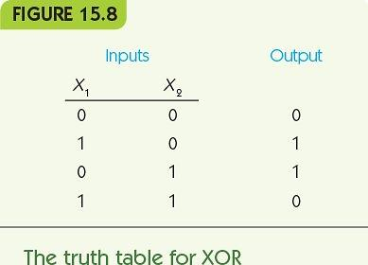
Recognition Tasks (9 of 12)
Networks with only input and output layers:
Can solve many problems, but
Cannot solve XOR (or many others)

Slide 24
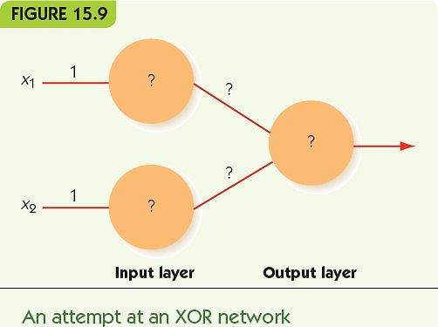
Recognition Tasks (10 of 12)

Slide 25
Recognition Tasks (11 of 12)
Add an intermediate layer between input and output
Hidden layer
Can solve most problems given the right weights
How can we determine the correct weights?
Neural networks are “trained” on sample data
Machine learning: the network “learns” correct responses to inputs

Slide 26
Recognition Tasks (12 of 12)
Training neural networks
Training data: input/output pairs where output is known to be correct for input
Output nodes that are incorrect have quantifiable error
Use error to update weights to generate less error
Backpropagation: algorithm that propagates errors back through hidden layer(s) to input

Slide 27
Reasoning Tasks Intelligent Searching (1 of 6)
Decision tree represents possible next items for which to search
Linear search and binary search assume:
Data is organized linearly
Exact match is required
What if we relax the requirements?
What if data is not linear?
What if an approximate match is okay?

Slide 28
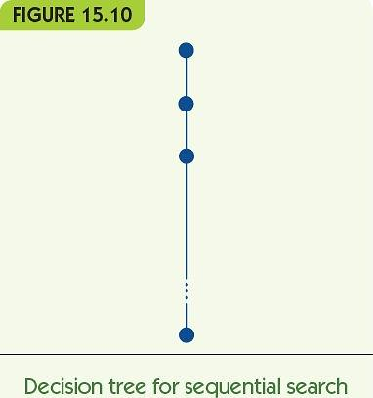
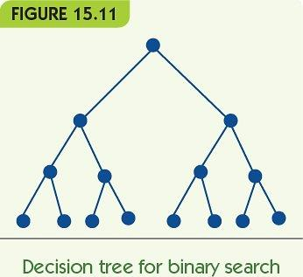
Reasoning Tasks Intelligent Searching (2 of 6)

Slide 29
Reasoning Tasks Intelligent Searching (3 of 6)
State–space graph
Each node is a state of our problem
A node connects to another if that state can be directly generated by the node
Examples: tic-tac-toe, eight-puzzle, maze-solving
Each node has many children
May be many paths to a goal
State–space search: seeks a path from start state to goal state

Slide 30
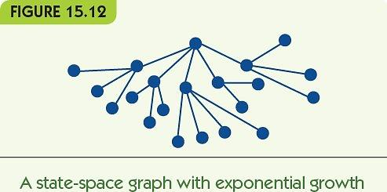
Reasoning Tasks Intelligent Searching (4 of 6)

Slide 31
Reasoning Tasks Intelligent Searching (5 of 6)
State–space graph
Each node is a state of our problem
A node connects to another if that state can be directly generated by the node
Examples: tic-tac-toe, eight-puzzle, maze-solving
Each node has many children
May be many paths to a goal
State–space search: seeks a path from start state to goal state

Slide 32
Reasoning Tasks Intelligent Searching (6 of 6)
Searching for a path to a goal
Brute force: trace all branches of decision tree
Too slow
Heuristics: use educated guess to guide which branches to search
Example: chess
Brute force is impossible
Good heuristics enable computers to play at grand master level
Chess is the last “easy” hard problem

Slide 33
Reasoning Tasks Swarm Intelligence
Swarm intelligence model
Model communities of simple agents, e.g., ants, termites, etc.
Ant colonies
Individuals exhibit simple behaviors
Colonies accomplish great things
Finding the shortest path to food
Constructing nests
Ant colony optimization: route-finding using simulated ants

Slide 34
Reasoning Tasks Intelligent Agents
Intelligent agent works with human user
Learns user’s preferences and takes actions on user’s behalf
Current examples
Personalized web search (push technology)
E-commerce site that tailors suggestions to your interests (recommendation software)
Future applications
Personal travel planner: buys tickets for user
Office manager: screens calls, arranges meetings

Slide 35
Reasoning Tasks Expert Systems (1 of 3)
Expert system: mimics reasoning in some specific domain
Knowledge base: knowledge about a domain
Inference engine: rules for reasoning with knowledge
Often use formal language to represent knowledge and rules for inference
Employ deductive reasoning, e.g., modus ponens

Slide 36
Reasoning Tasks Expert Systems (2 of 3)
Expert system reasoning
Forward chaining
Start with assertions ► look for rules to deduce new assertions
Given assertion A and rule “if A then B” ► deduce B
Backward chaining
Start with a query ► look for rules that could deduce query
Given question “Is B true?” and rule “if A then B” ► try to determine “Is A true?”

Slide 37
Reasoning Tasks Expert Systems (3 of 3)
Explanation facility
Users can see explanation based on the reasoning chain
Knowledge engineering
Human system builders must spend time with experts
Listing and codifying the expert knowledge

Slide 38
Reasoning Tasks The Games We Play (1 of 6)
Board games
Many programs use forms of state-space search
Tic-tac-toe
Small state space
Brute force works to play perfectly
Checkers
Chinook project built and searched the complete state space
Results can be embedded in a computer player
Chinook can never be beaten

Slide 39
Reasoning Tasks The Games We Play (2 of 6)
Chess
State space is too large to solve
Computer players depend on heuristics
Deep Blue defeated world champion Gary Kasparov (1997)
Go
Huge search space
Difficult for a computer to play well
Current research is underway to reach top levels

Slide 40
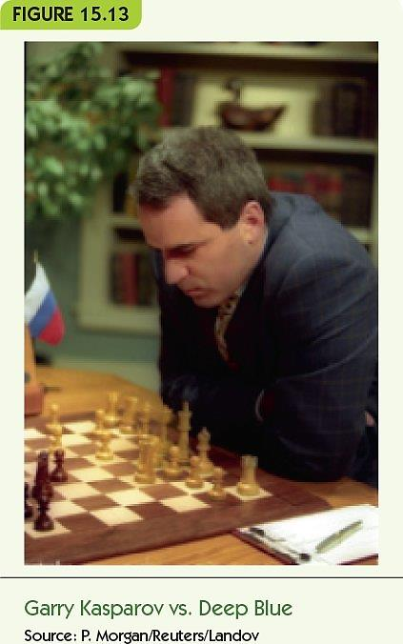
Reasoning Tasks The Games We Play (3 of 6)

Slide 41
Reasoning Tasks The Games We Play (4 of 6)
Quiz games: Jeopardy!
Watson defeated Jeopardy! Champions (2011)
Given a quiz “answer” and category:
Applies multiple kinds of AI agents to search database (of information from the web)
Produces 300-500 candidate answers
Narrows to one answer and evaluates its certainty in real time
Scoring and evaluation are done in parallel

Slide 42
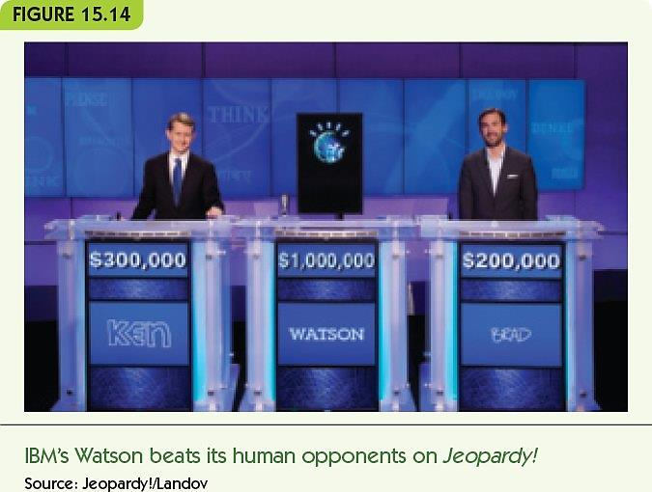
Reasoning Tasks The Games We Play (5 of 6)

Slide 43
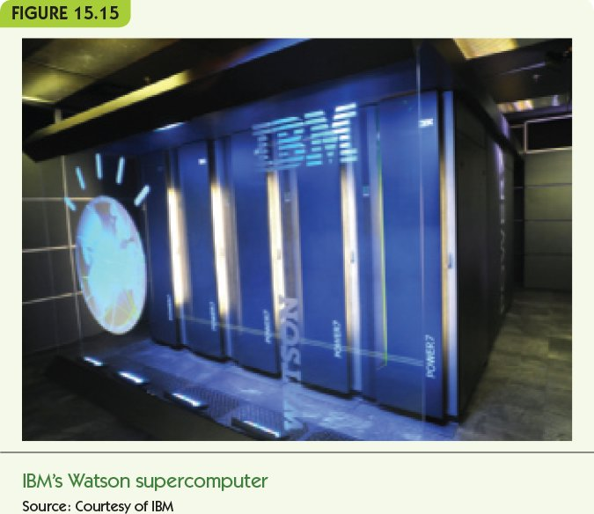
Reasoning Tasks The Games We Play (6 of 6)

Slide 44
Robots and Drones (1 of 5)
A robot is a physical device that takes in sensory data and makes autonomous responses
Current robot tasks
Repetitive or dangerous for humans
Manufacturing, bomb disposal, search-and-rescue
New research on multiple cooperating robots
Schools of robot fish for studying sea life
Swarms of robot flies for reconnaissance
Groups of robot snowmobiles to study climate change

Slide 45
Robots and Drones (2 of 5)
Humanoid robots are designed for interacting with people
Help elderly or hospital patients
Monitor small children
Japan is a leader in humanoid robots
Aging population needs support
Asimo, by Honda
Designed to walk and move fluidly and robustly
Can open/close a door to go through, serve refreshments, etc.

Slide 46
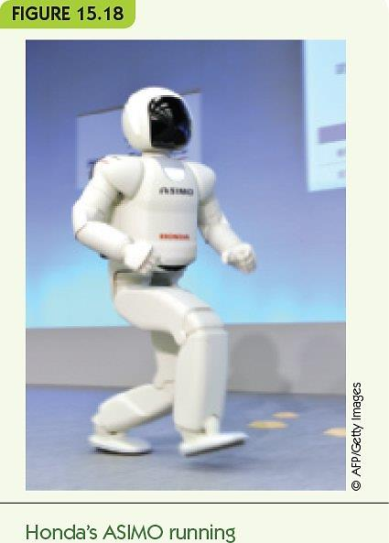
Robots and Drones (3 of 5)

Slide 47
Robots and Drones (4 of 5)
Deliberative strategy for robot control programs
Maintain detailed internal model of the world
Reason about sensory inputs and choose best response
Reactive strategy
Limit/eliminate internal model
React immediately to sensory inputs
Rapid cycle from inputs to responses to more inputs

Slide 48
Robots and Drones (5 of 5)
Drone
Unmanned Aerial Vehicle (UAV)
Controlled by a human at a remote site
Primarily used by military and law enforcement
Potential uses
Deliver medical supplies
Monitor dangerous situations, e.g., fires, floods, etc.
Document wildlife
Document urban traffic

Slide 49
Summary (1 of 2)
Artificial intelligence programs solve problems in “intelligent” ways
Knowledge may be represented in many different ways; choice of representation depends on task
Neural networks simulate the connectionist structure of the nervous system
Neural networks are trained to produce the correct responses to inputs
Reasoning may often be state–space search

Slide 50
Summary (2 of 2)
Swarm intelligence uses colonies of simple agents to solve problems
Intelligent agents would be artificial personal assistants
Expert systems reason with expert domain knowledge
Game-playing is a common application for AI
Robots perform tedious and dangerous tasks
Drones are unmanned aerial vehicles

